Slide 1
Software Development with Java
Dzmitry Marchankau 2024

Slide 2
Course summary
Java Core
Data structures and collections, exceptions, mulithreading
Web development with Spring Framework
Web services and web applications
Functional programming with Java
Stream API, lambda functions
Data persistence
Databases, frameworks
Client-side applications Responsive design, multiplatform solutions
Cloud solutions Cloud native
Software development best practices Patterns, SDLC, methodologies

Slide 3
Course structure
16 lectures (theoretical)
8 workshops (practical)
Exam

Slide 4
Why Java is in this course?
Developed eco-system and community
Popular technology stack for web and BE development
High-Level, object oriented and strongly typed language Runtime environment (JRE)
for Windows/Linux/Cloud targeted to multi-platform development

Slide 5
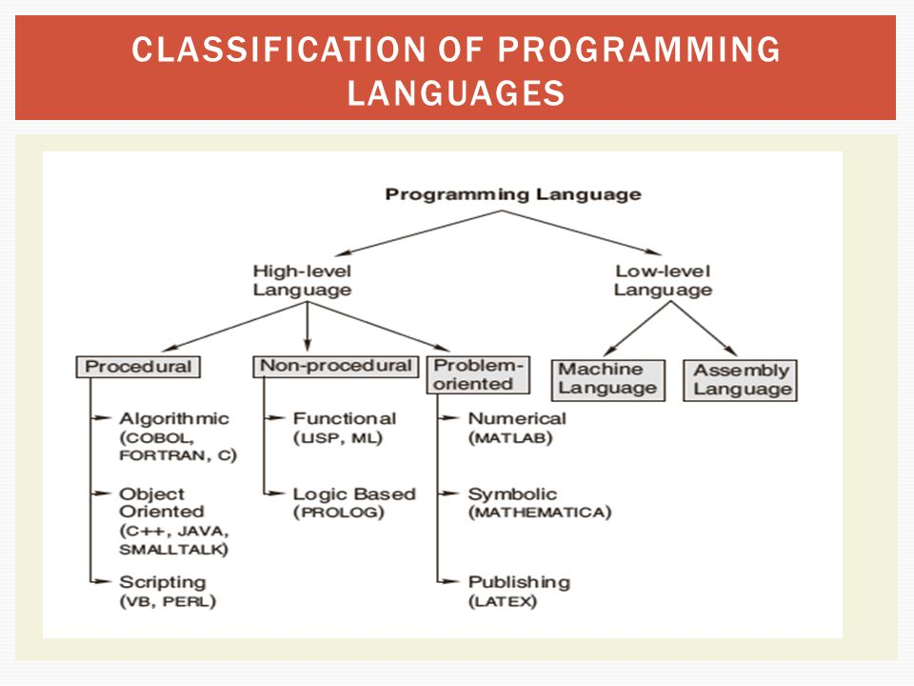
Languages classification (years ago)

Slide 6
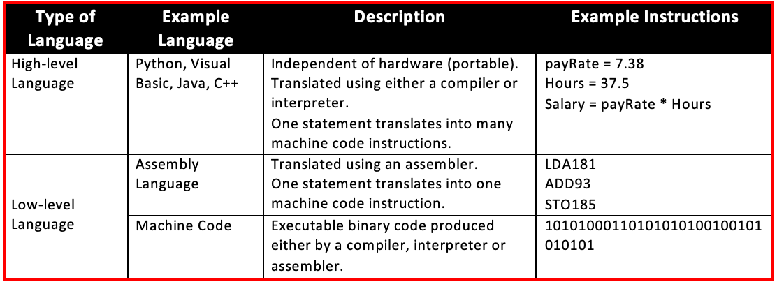
Languages classification by level

Slide 7
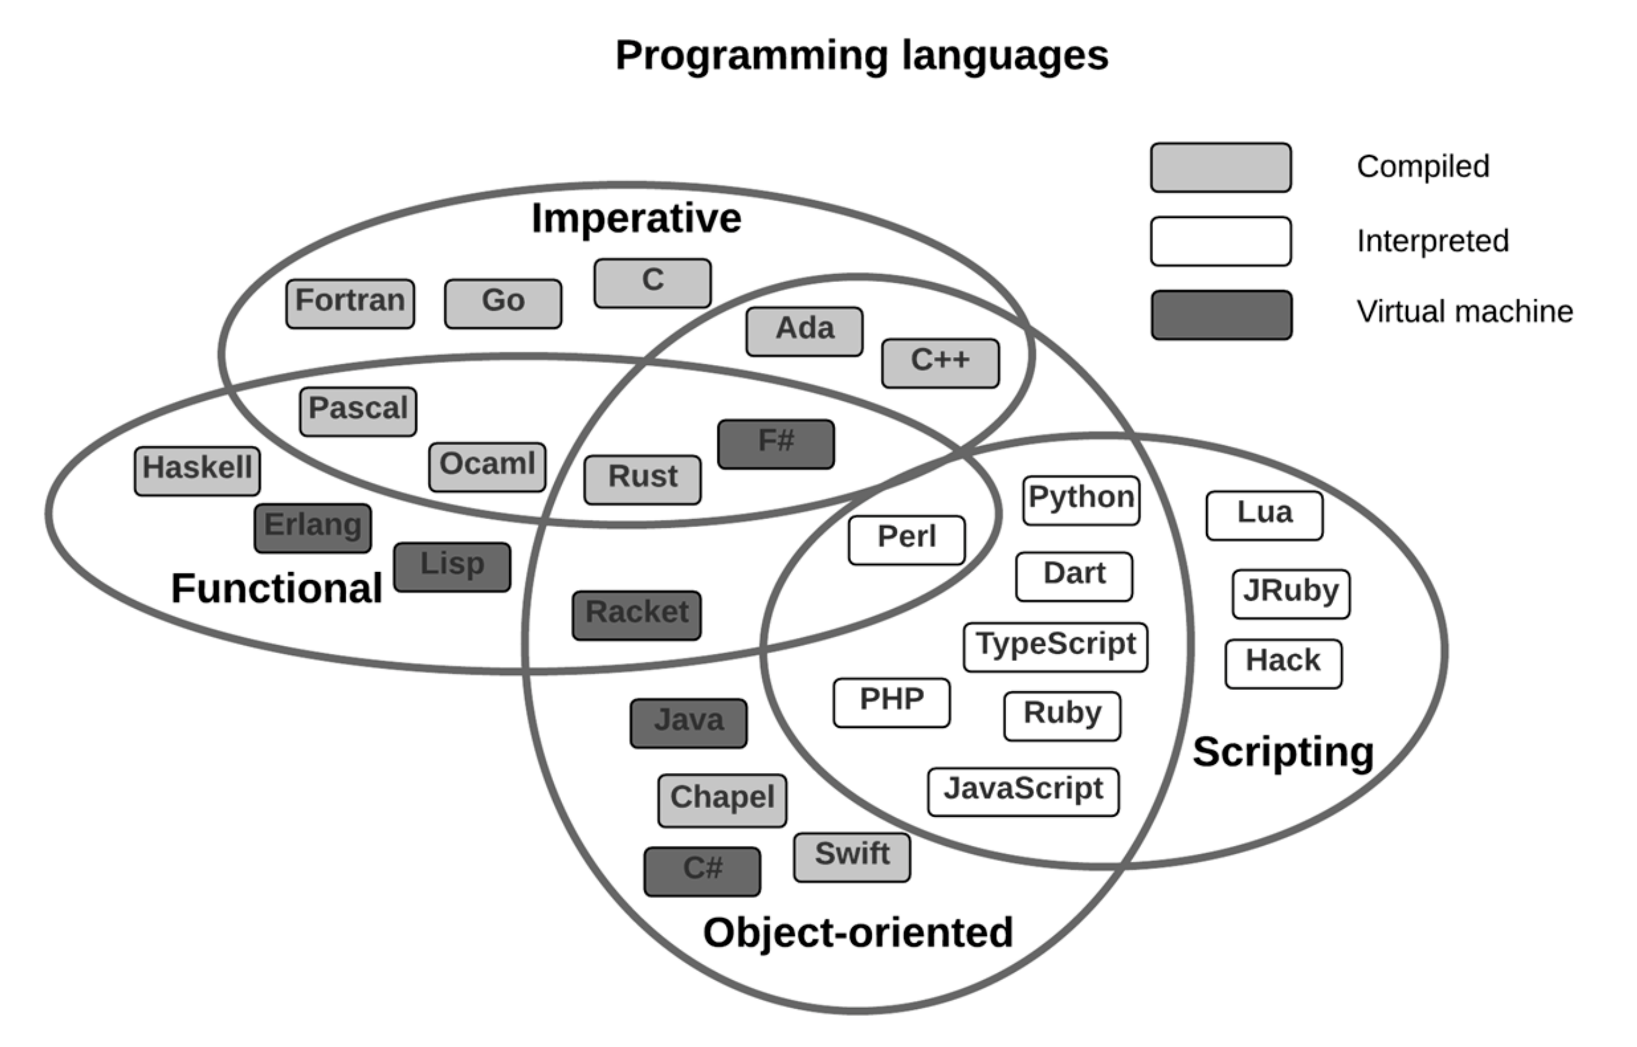
Languages classification (modern)

Slide 8
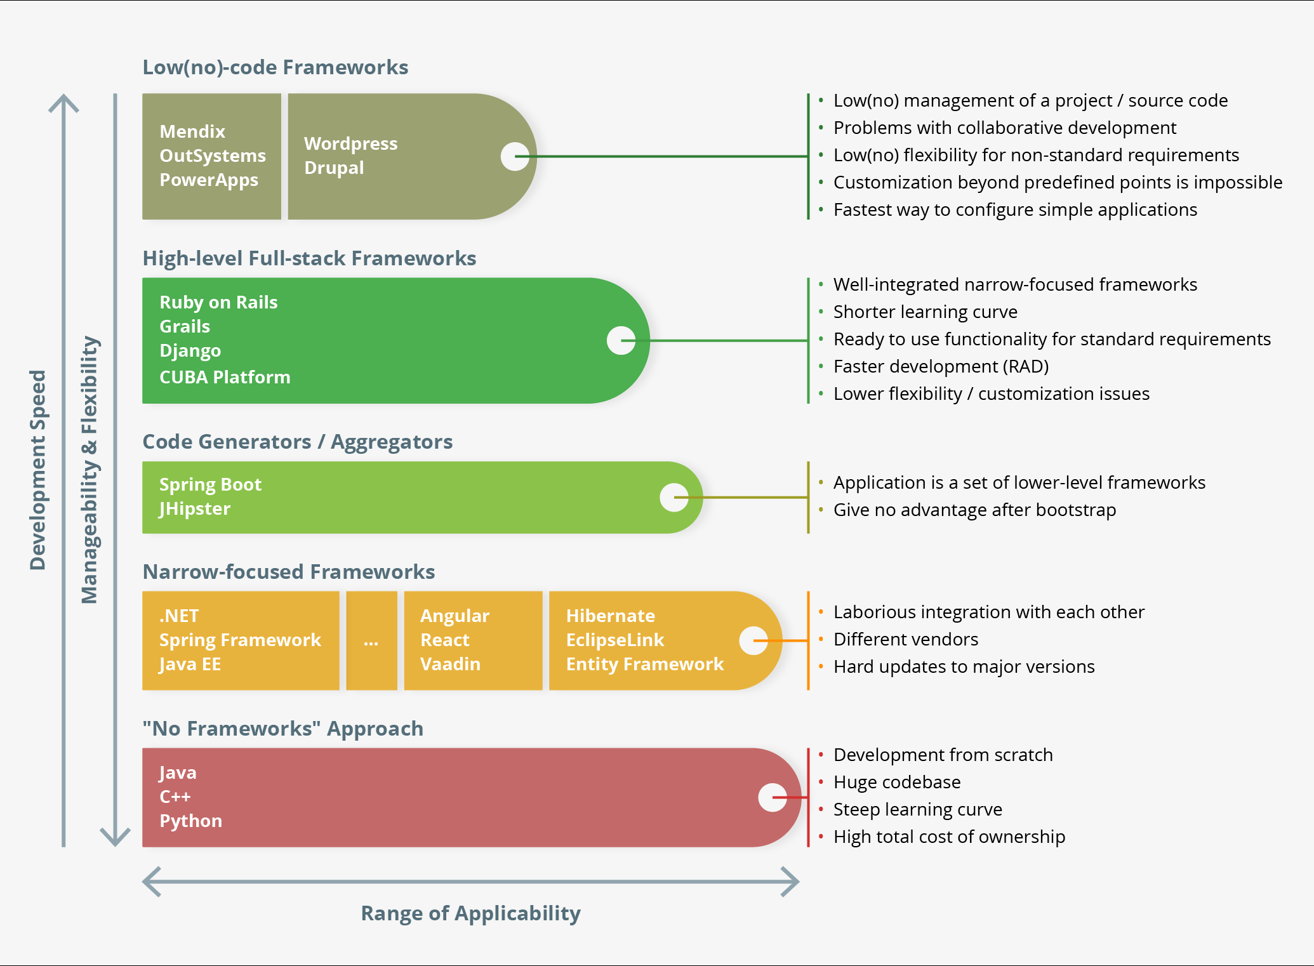
Dev frameworks classification

Slide 9
Quick start with Java
Basic terms: Java Virtual Machine Java Development Kit Java Runtime Environment
Tools:
IDE (IntelliJ IDEA, Eclipse)

Slide 10
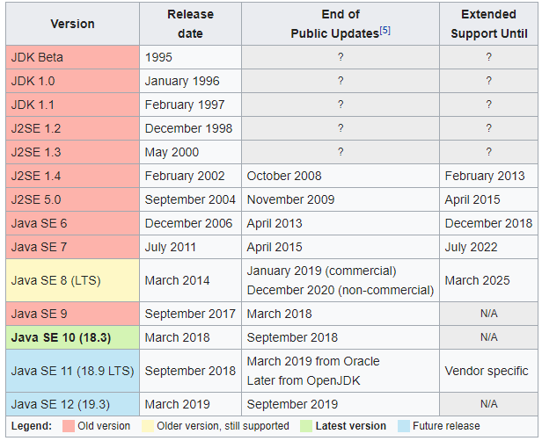
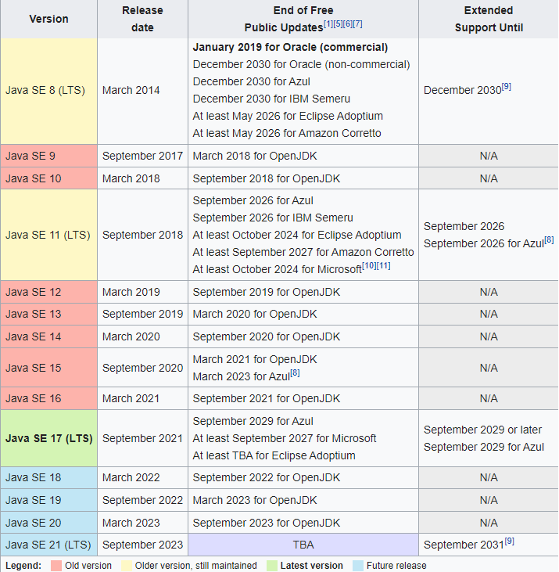
Java history and versions

Slide 11
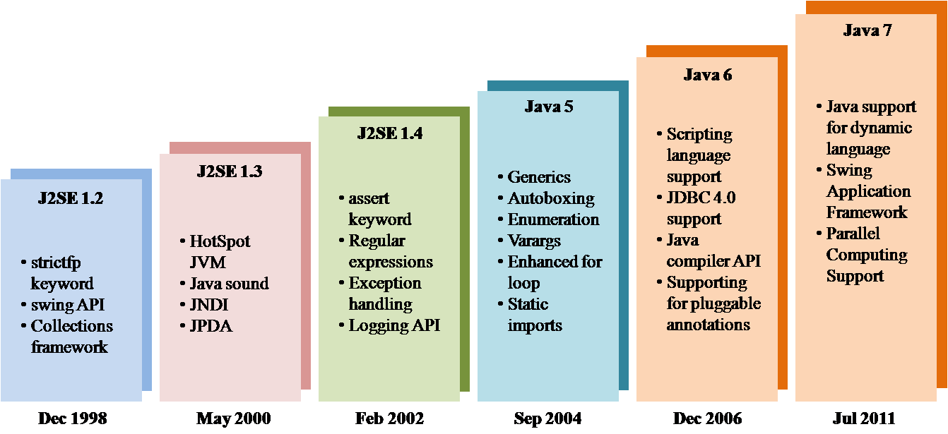
Java evolution

Slide 12
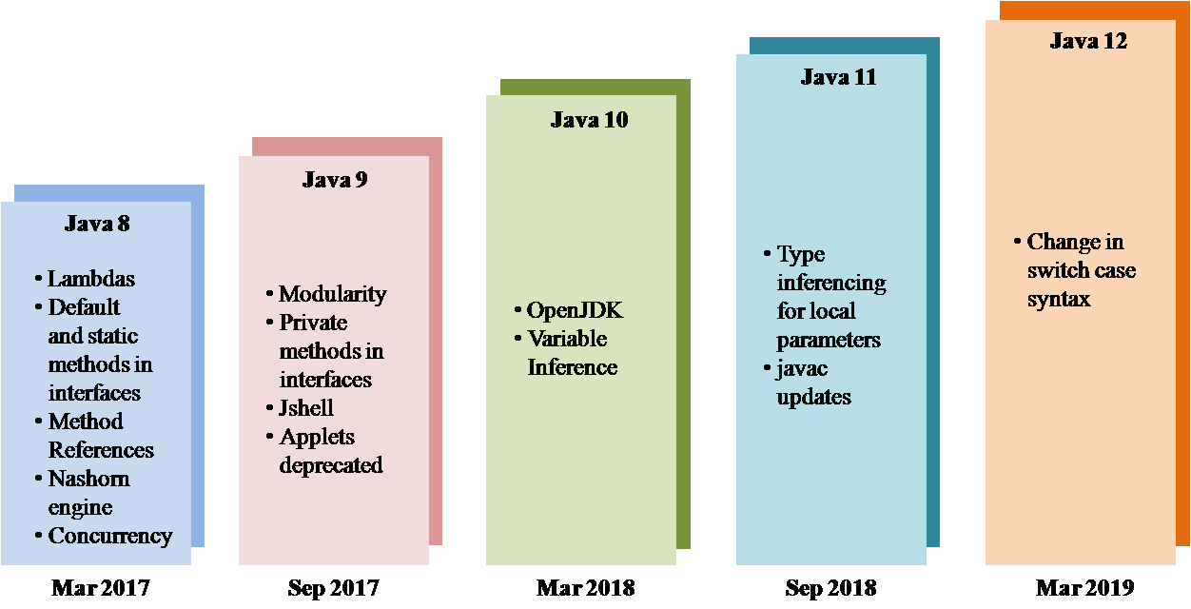
Java evolution

Slide 13
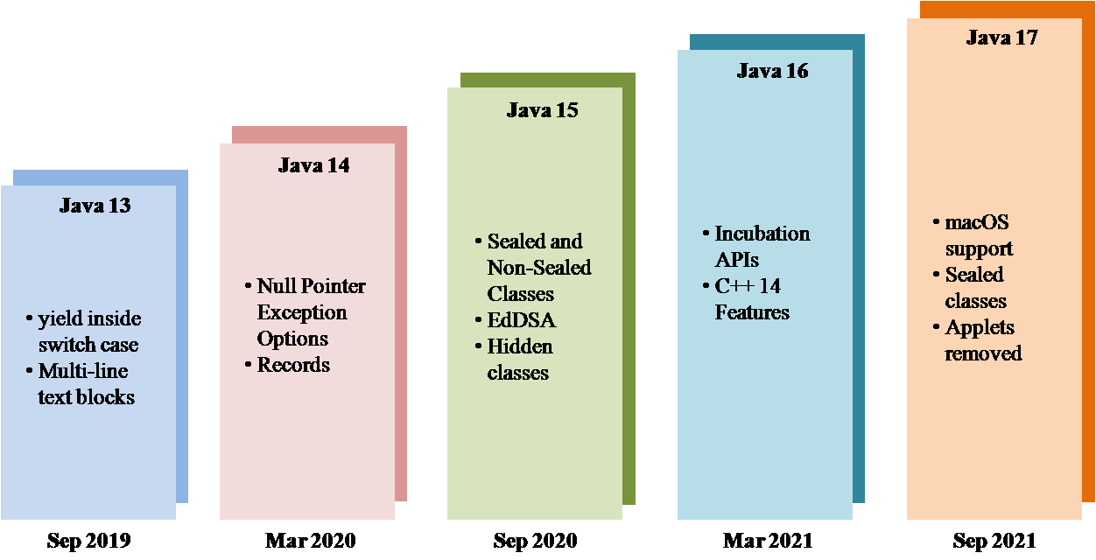
Java evolution

Slide 14
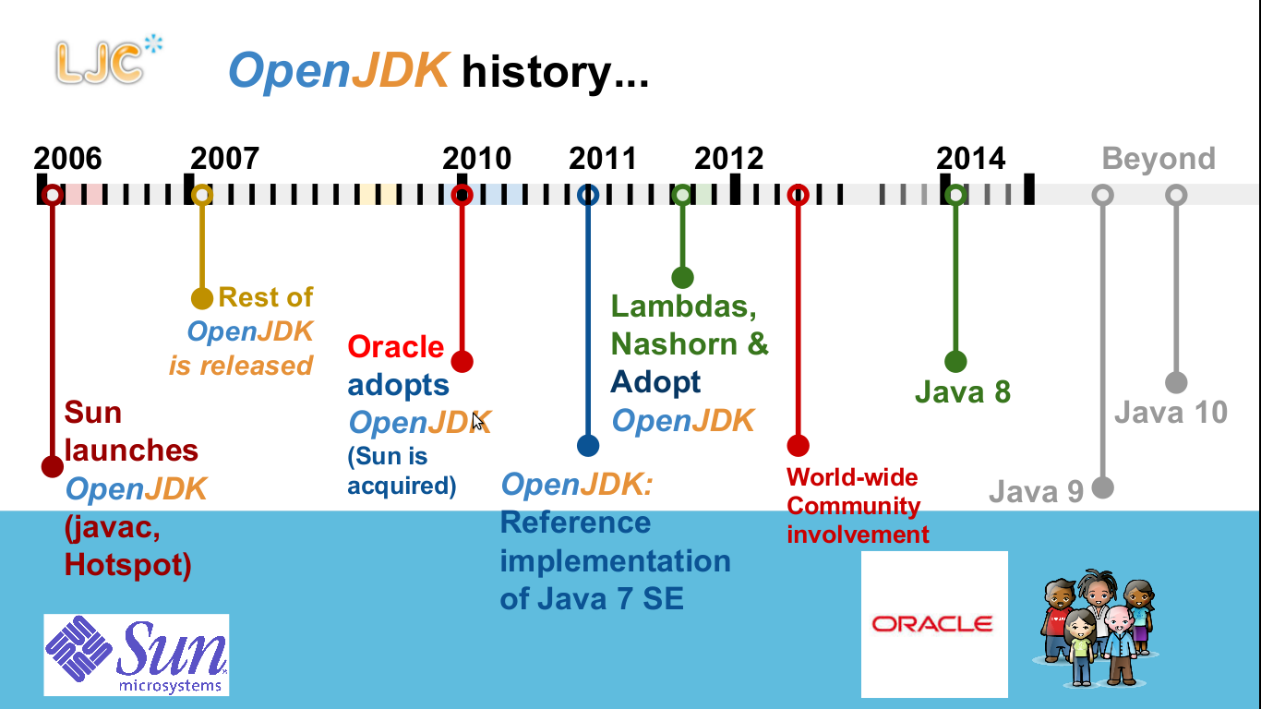
Java evolution

Slide 15
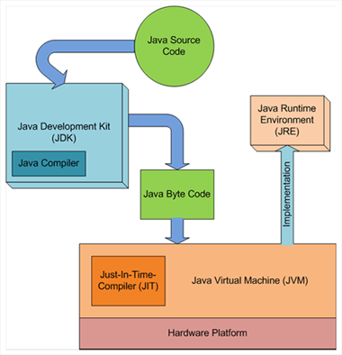
Java runtime environment
Notes:
A Java virtual machine (JVM) is a virtual machine that enables a computer to run Java programs as well as programs written in other languages that are also compiled to Java bytecode. The JVM reference implementation is developed by the OpenJDK project as open source code and includes a JIT compiler called HotSpot. The commercially supported Java releases available from Oracle are based on the OpenJDK runtime. Eclipse OpenJ9 is another open source JVM for OpenJDK.

Slide 16
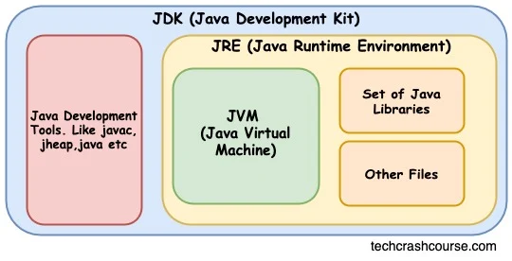
Java runtime environment

Slide 17
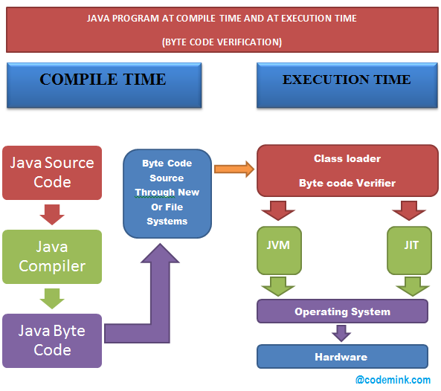
Java runtime environment

Slide 18
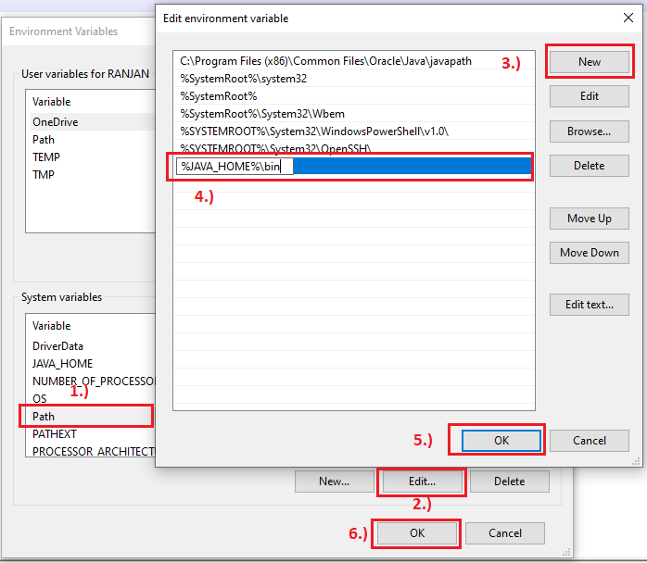
JDK setup (Windows)

Slide 19
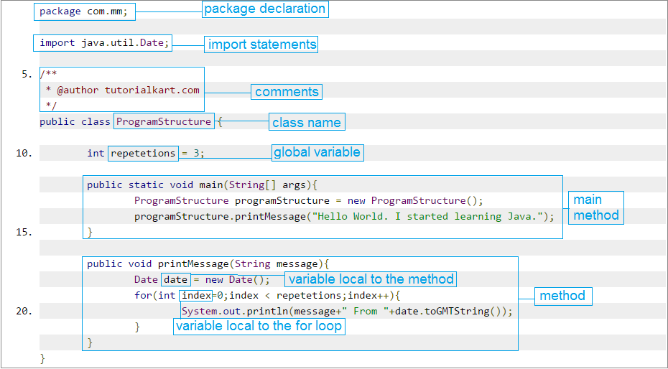
Java program structure

Slide 20
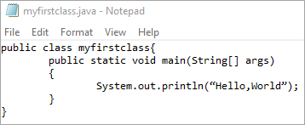
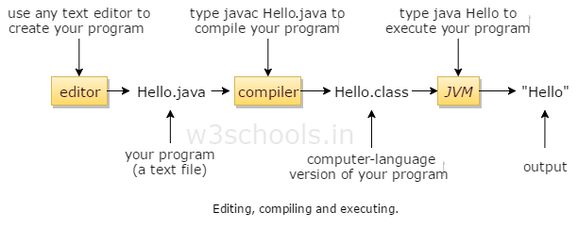
Compiling and running Java code

Slide 21
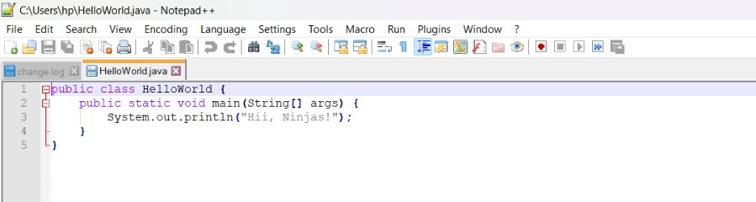
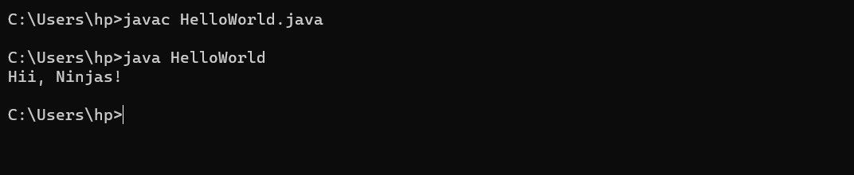
Running simple Java code

Slide 22
Running Java code
Using IDE
You can improve your development experience for Java programs by using IDE ( Integrated Development Environment ). Here are some steps to start:
First, download and install an IDE on your pc. You can use Eclipse, IntelliJ IDEA, or NetBeans.
Now, create a new Java project in the IDE. Give it a name.
Next, create a new Java class in the project. Add your code to it.
Finally, run the IDE program to see the output and debug any issues.
You can use IDE features like auto-completion, syntax highlighting, and error checking to improve your code.

Slide 23
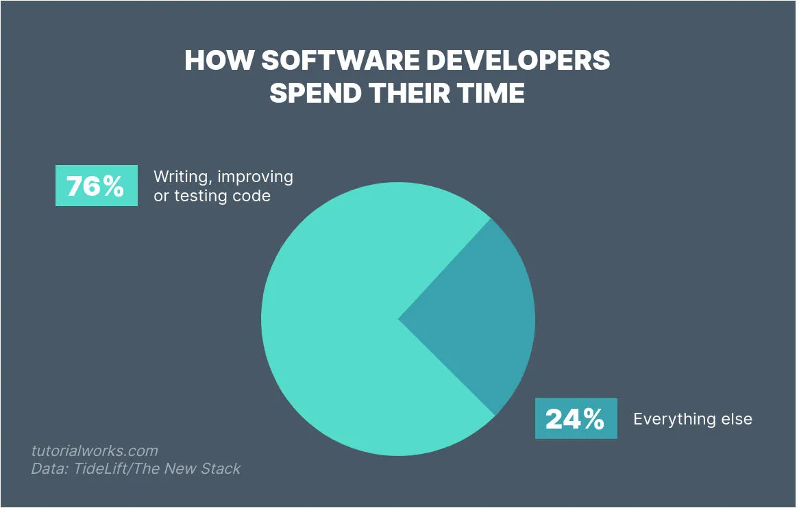
IDE (Integrated Development Environment)
An IDE is usually responsible for these things:
Code editor
Compiling code
Running tests

Slide 24
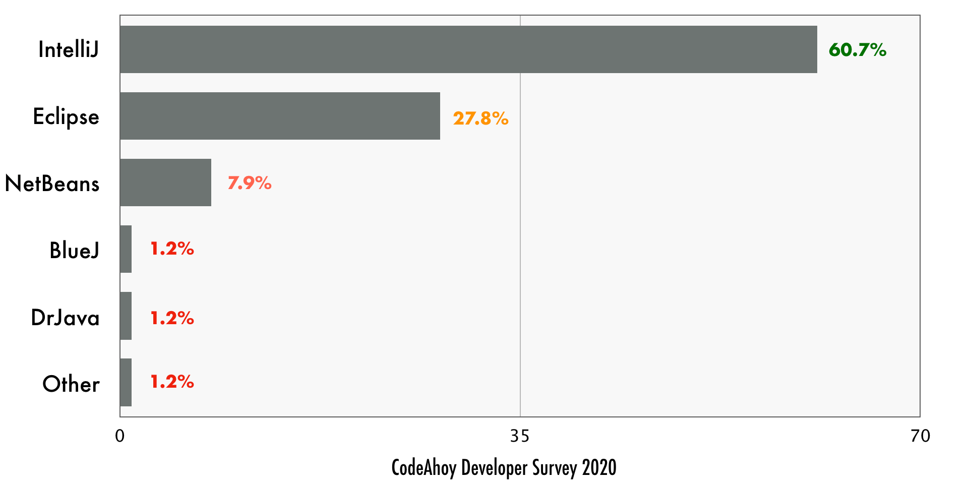
IDE for Java

Slide 25
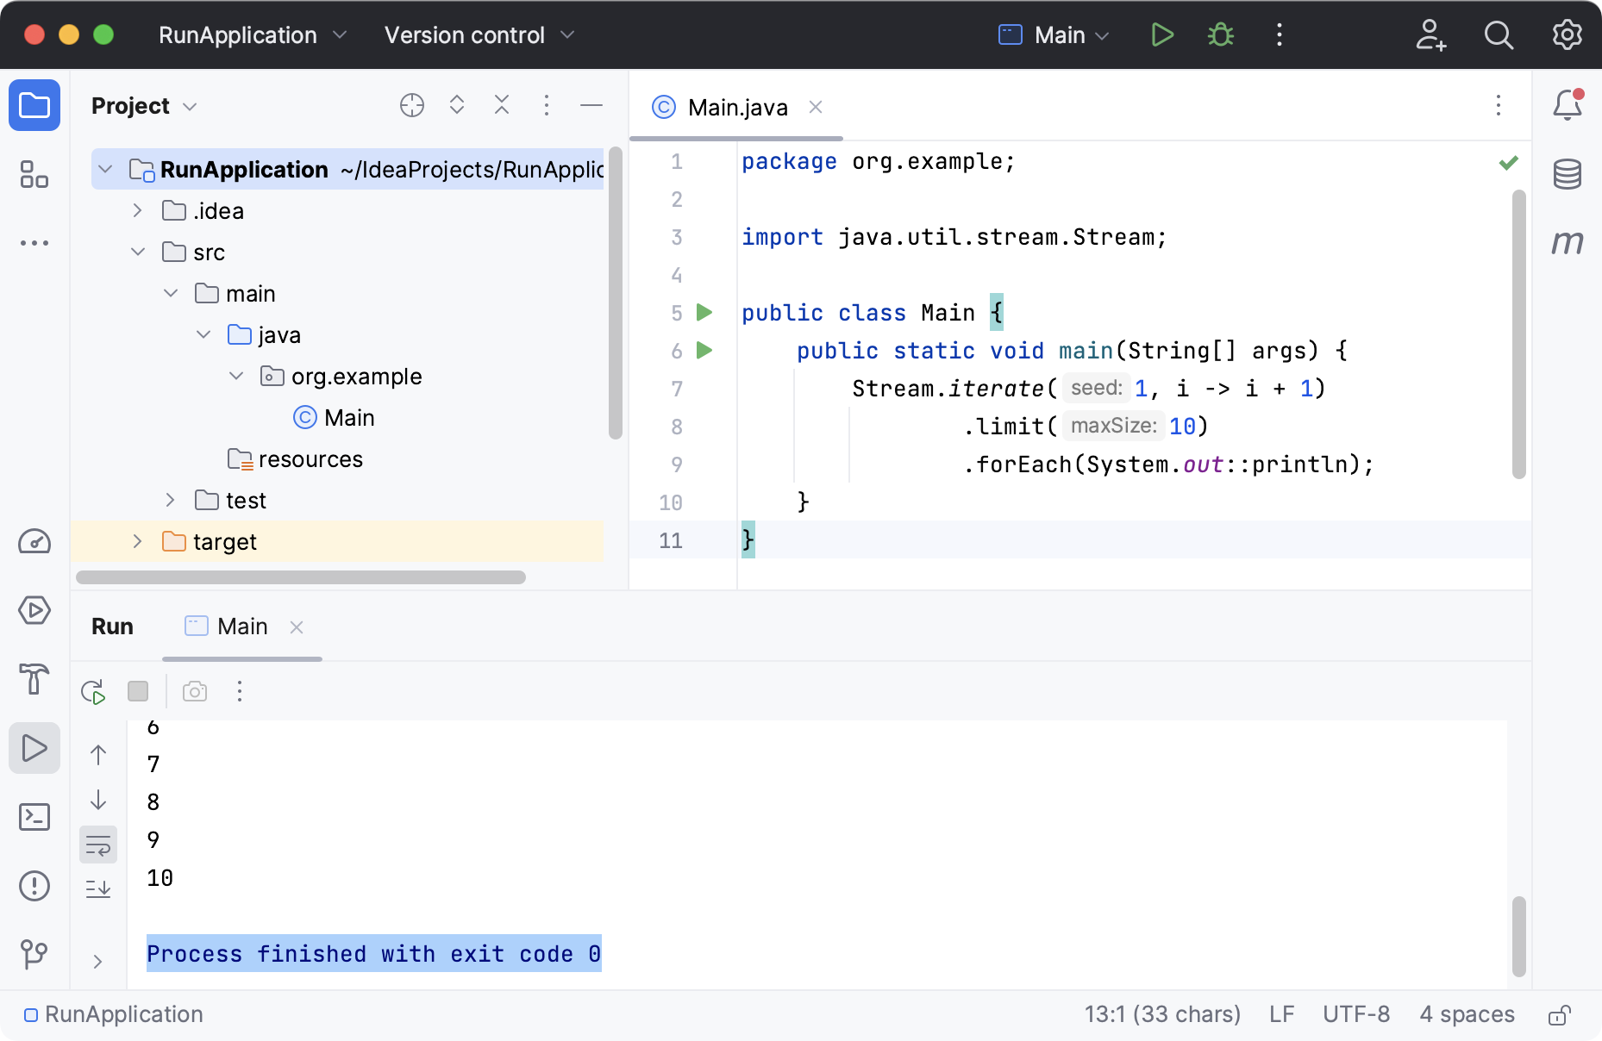
Running Java code

Slide 26
Cross-platform development with Java
Native vs multiplatform (cross-platform)
Platforms:
Device (desktop, tablet, mobile, play station) OS (Android, iOS, macOS, Linux, Windows) Runtime Environment (JRE, Docker)
Common approaches: - same codebase but different execution code for different runtime environment (Java) - script-like languages (JavaScript, bash, python)

Slide 27
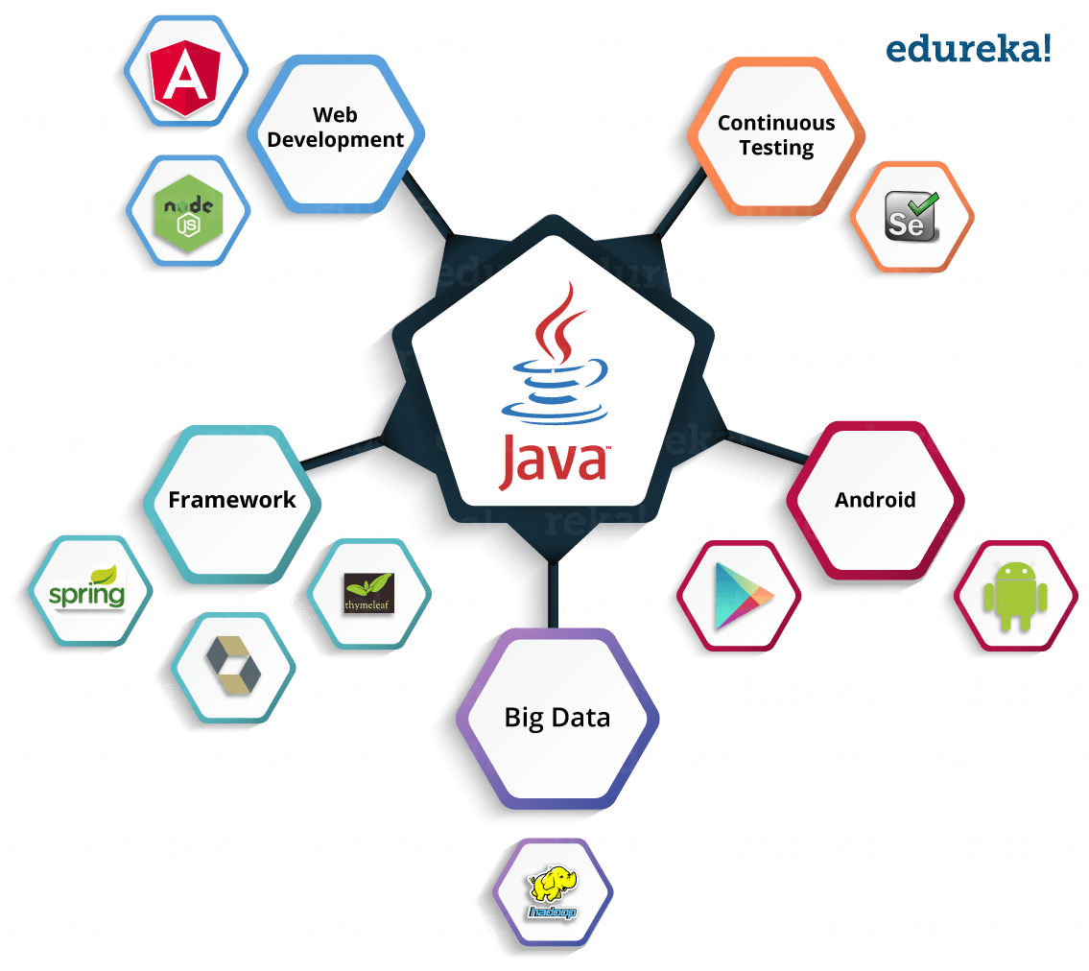
Java ecosystem

Slide 28
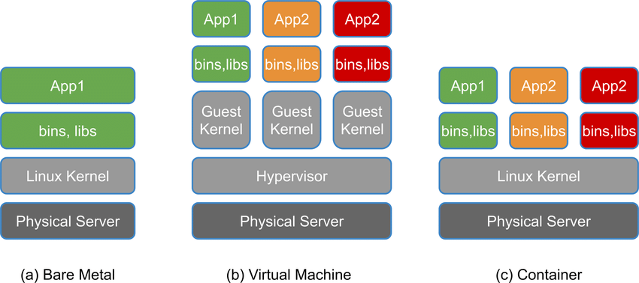
Virtual machine vs container

Slide 29
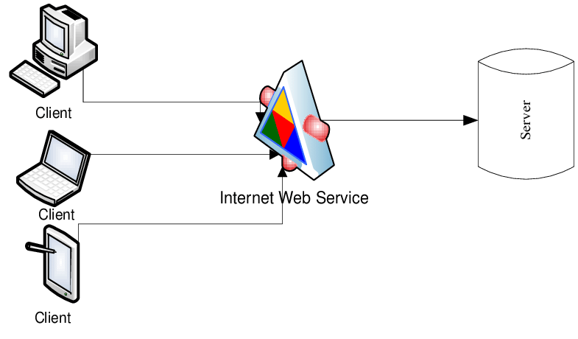
Client-Server architecture

Slide 30
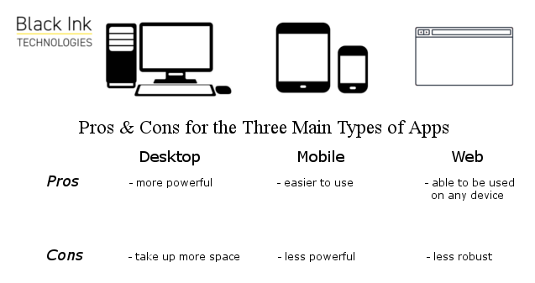
Web applications

Slide 31
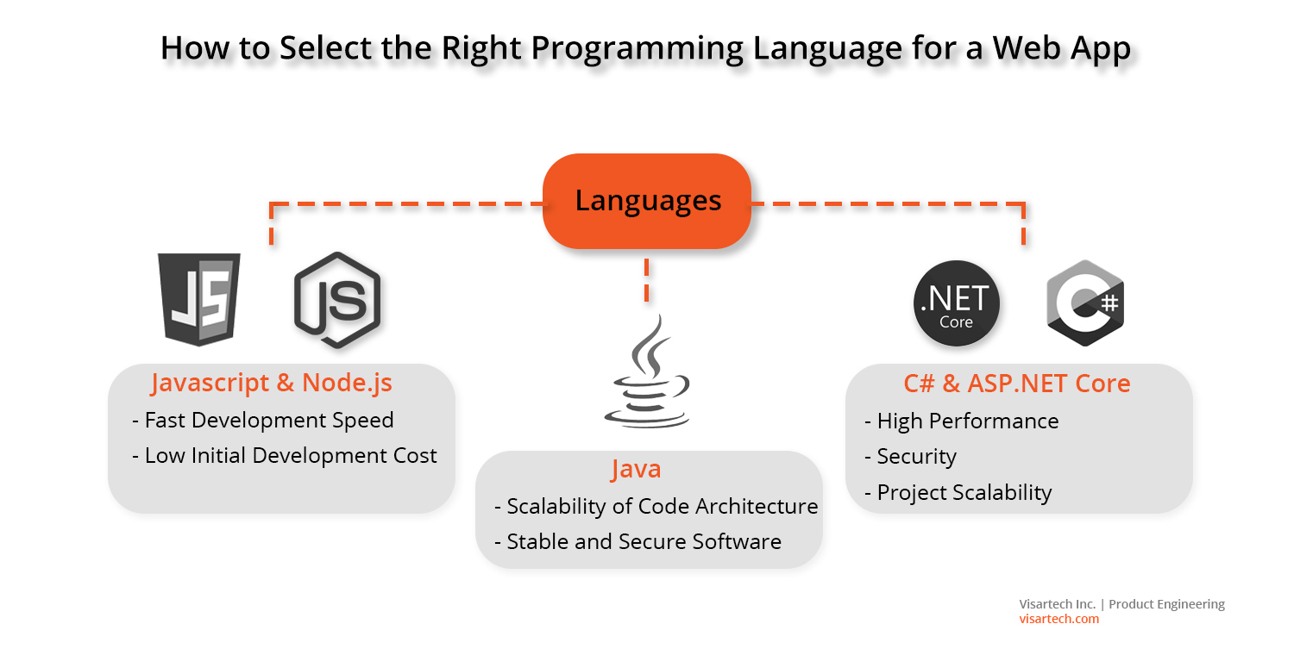
Java for web development

Slide 32
Web applications and web services
WWW, Internet
Protocols, HTTP
HTTP Servlets, requests, responses

Slide 33
WWW
The World Wide Web (WWW), commonly known as the Web, is an information system where documents and other web resources are identified by Uniform Resource Locators (URLs, such as https://example.com/), which may be interlinked by hyperlinks, and are accessible over the Internet. The resources of the Web are transferred via the Hypertext Transfer Protocol (HTTP), may be accessed by users by a software application called a web browser, and are published by a software application called a web server. The World Wide Web is built on top of the Internet, which pre-dated the Web by over two decades.

Slide 34
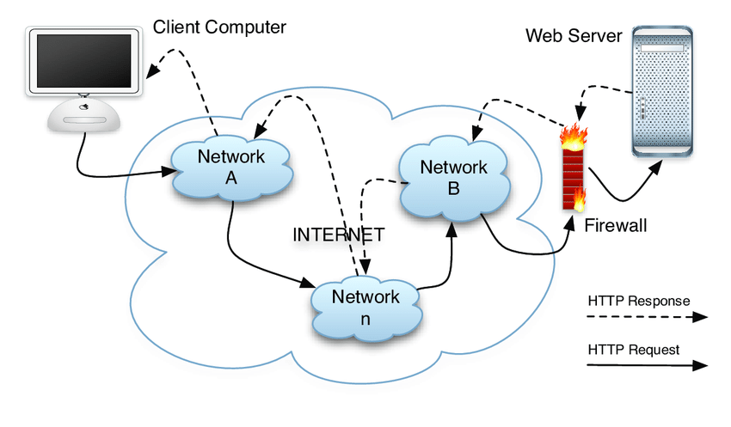
WWW over Internet

Slide 35
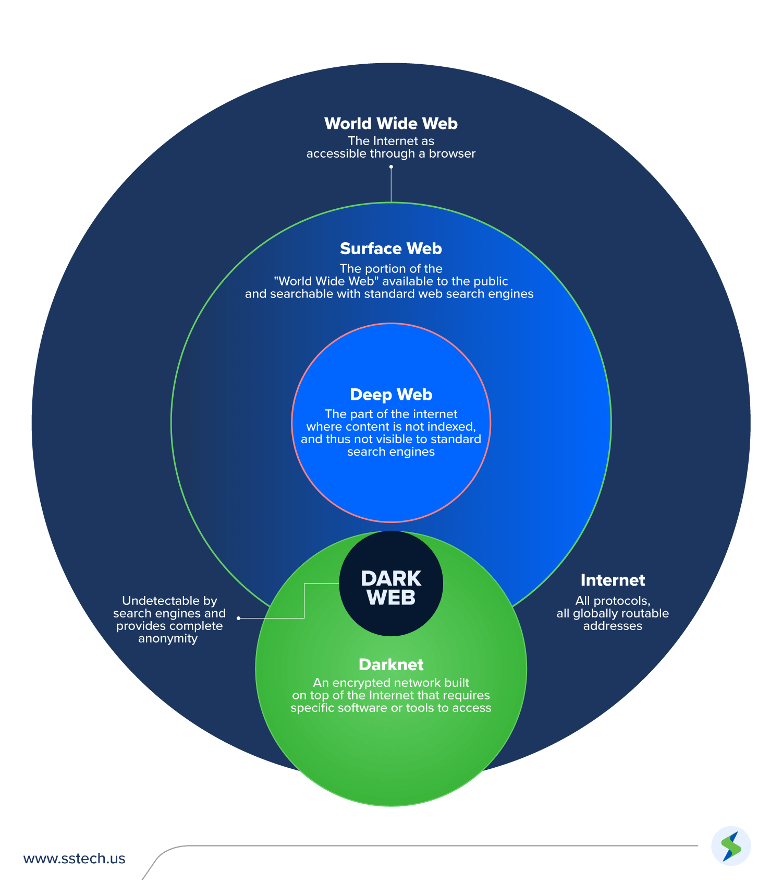
What else is in Internet?

Slide 36
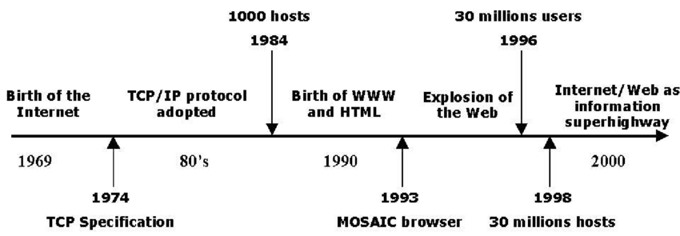
History of Internet

Slide 37
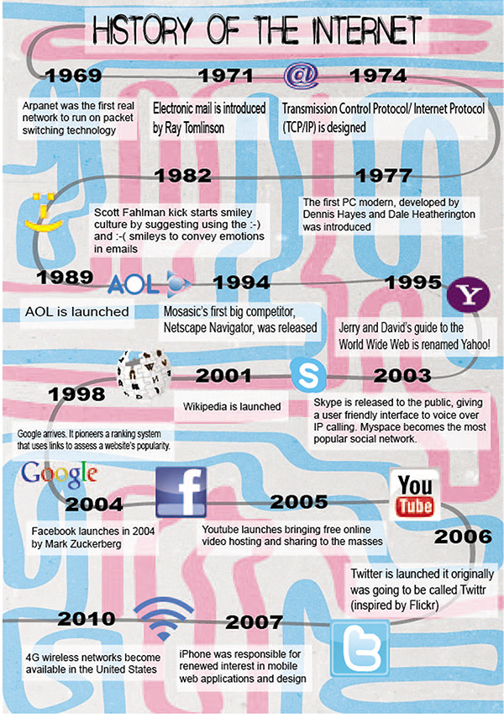

Slide 38
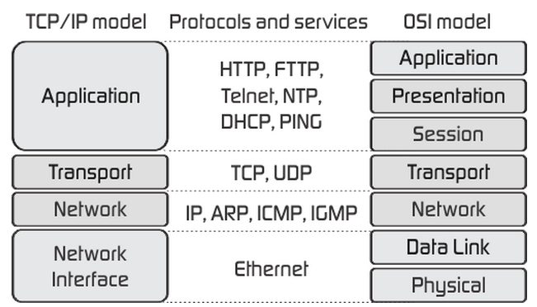
OSI (Open System Interconnection) model

Slide 39
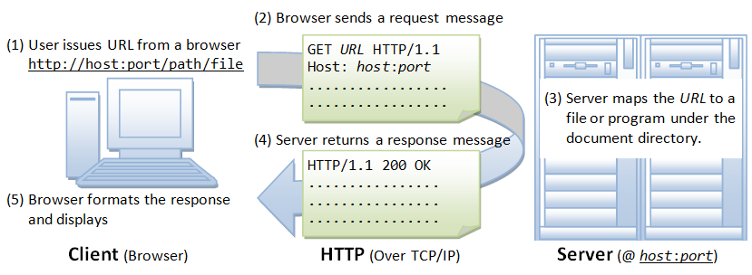
HTTP protocol

Slide 40
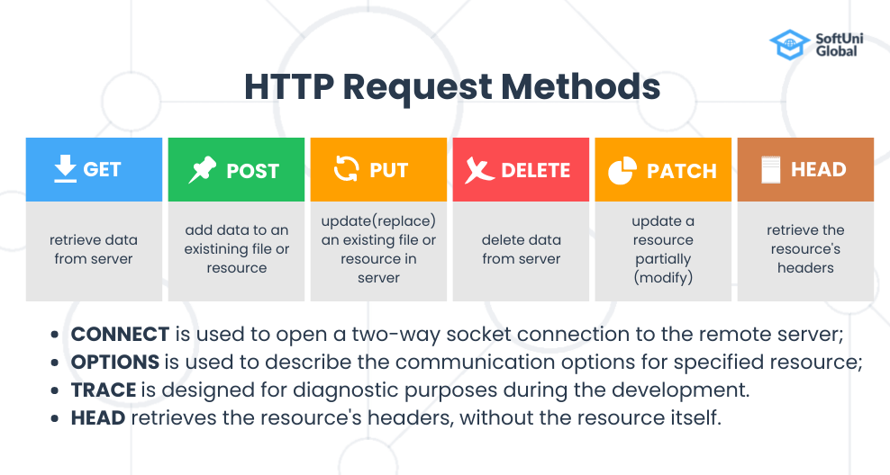
HTTP protocol

Slide 41
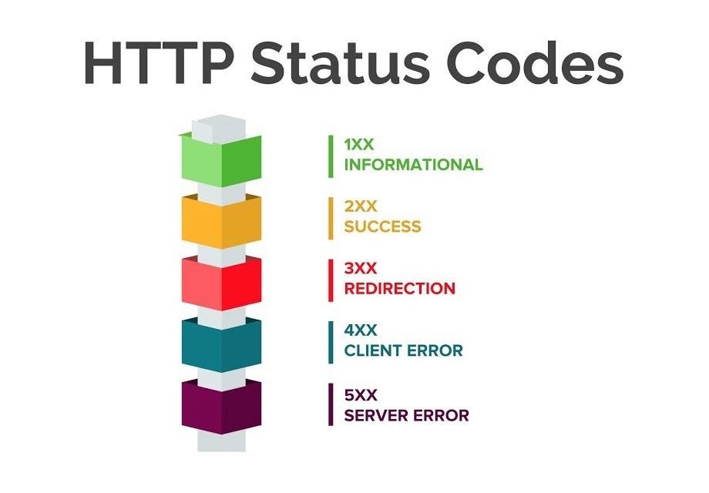
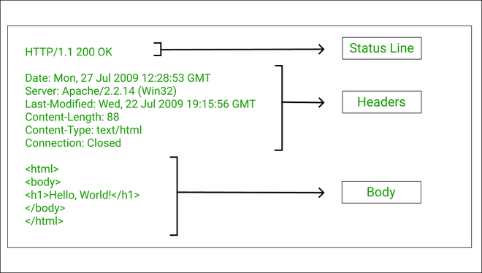
HTTP protocol: response

Slide 42
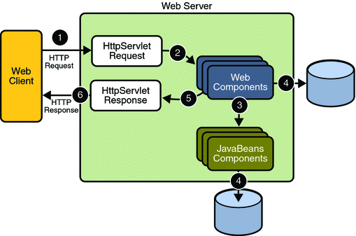
HTTP request processing in Web apps

Slide 43
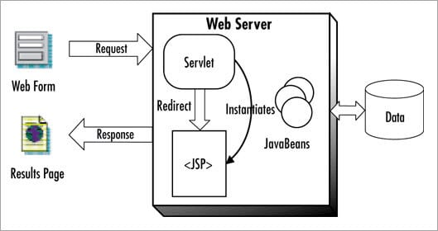
Servlet and JSP

Slide 44
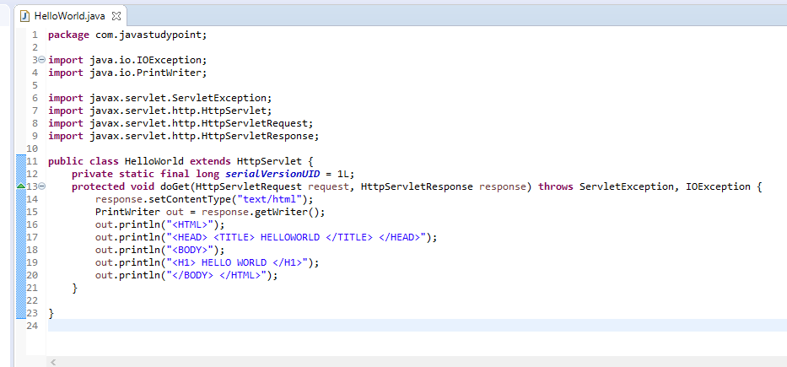
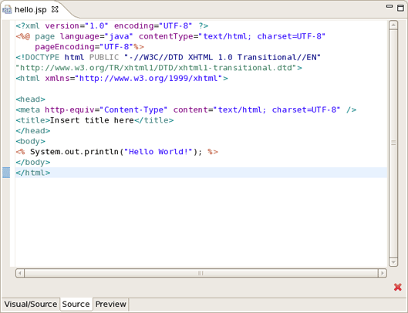
Servlet and JSP

Slide 45
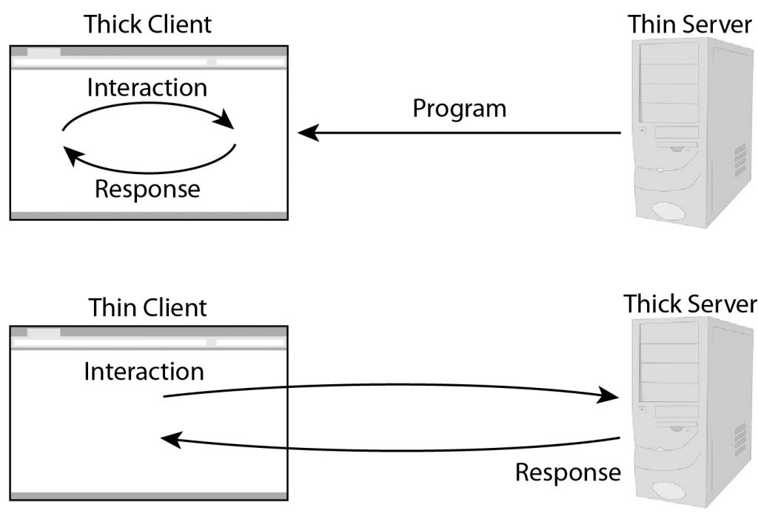
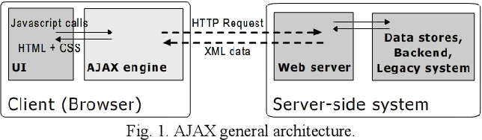
Client-server architecture, rich clients

Slide 46
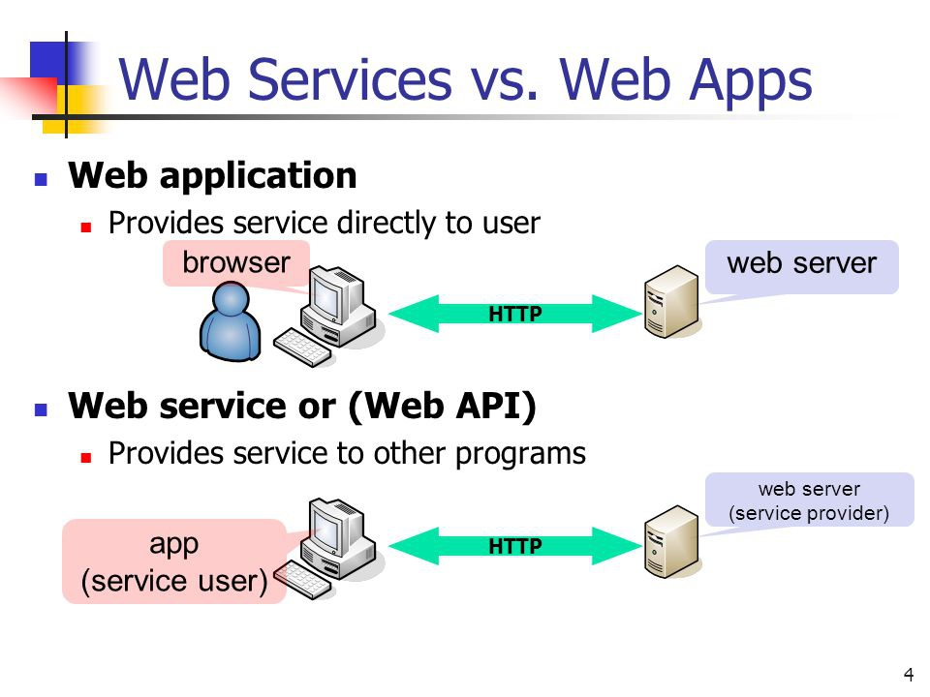
Web apps and web services

Slide 47
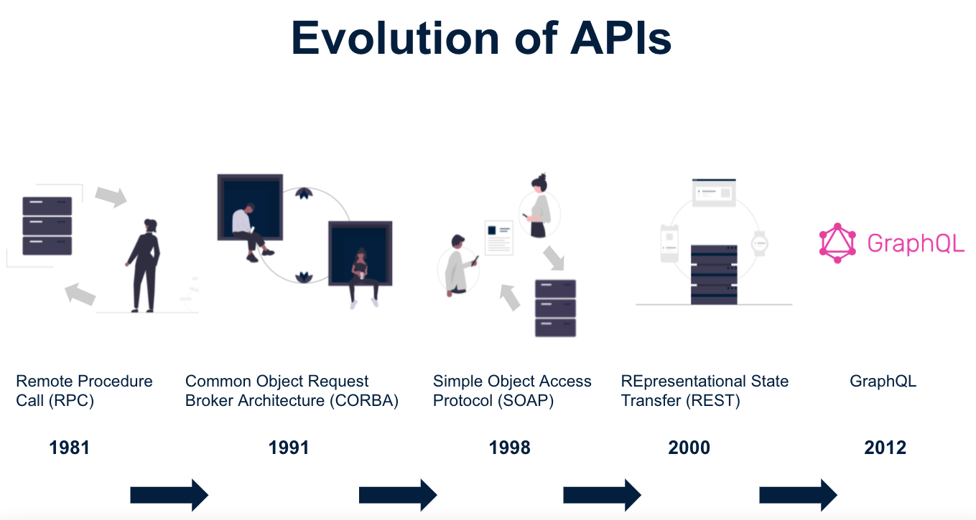
APIs (+gRPC since 2015)

Slide 48
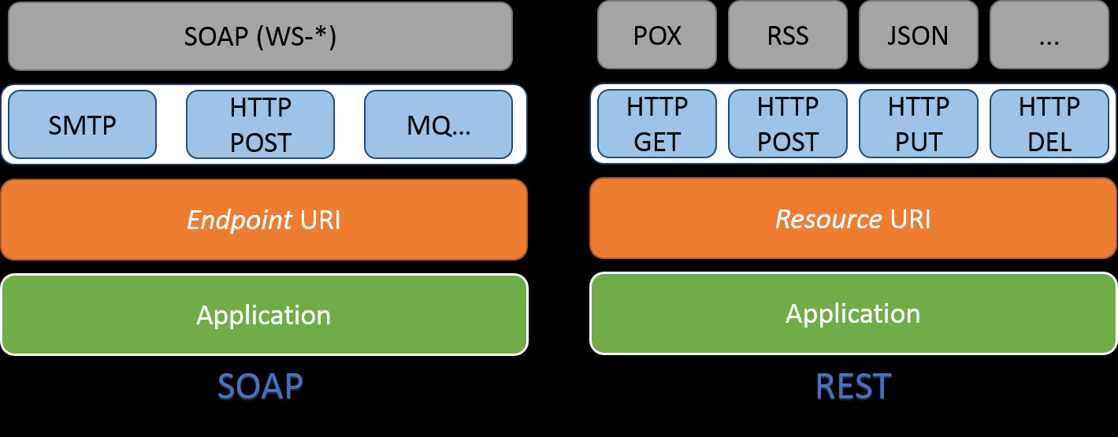
SOAP vs REST

Slide 49
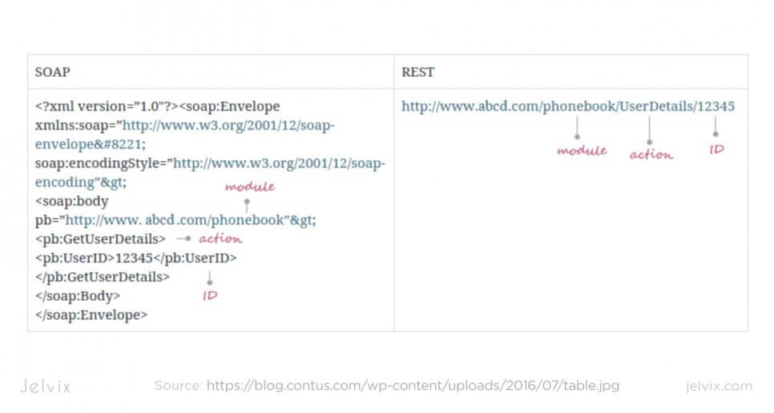
SOAP vs REST

Slide 50
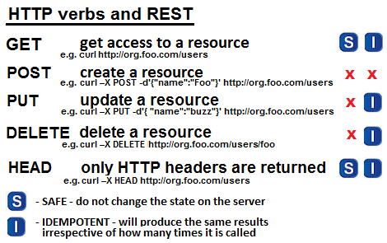
REST and HTTP

Slide 51
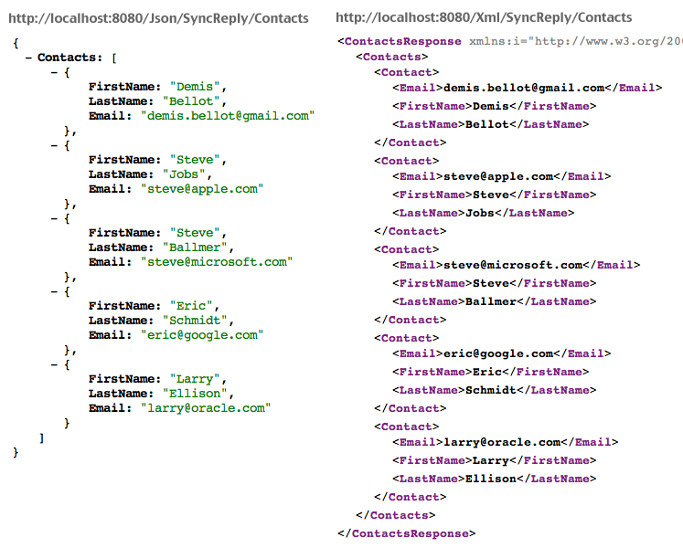
JSON vs XML

Slide 52
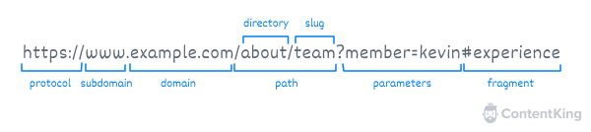
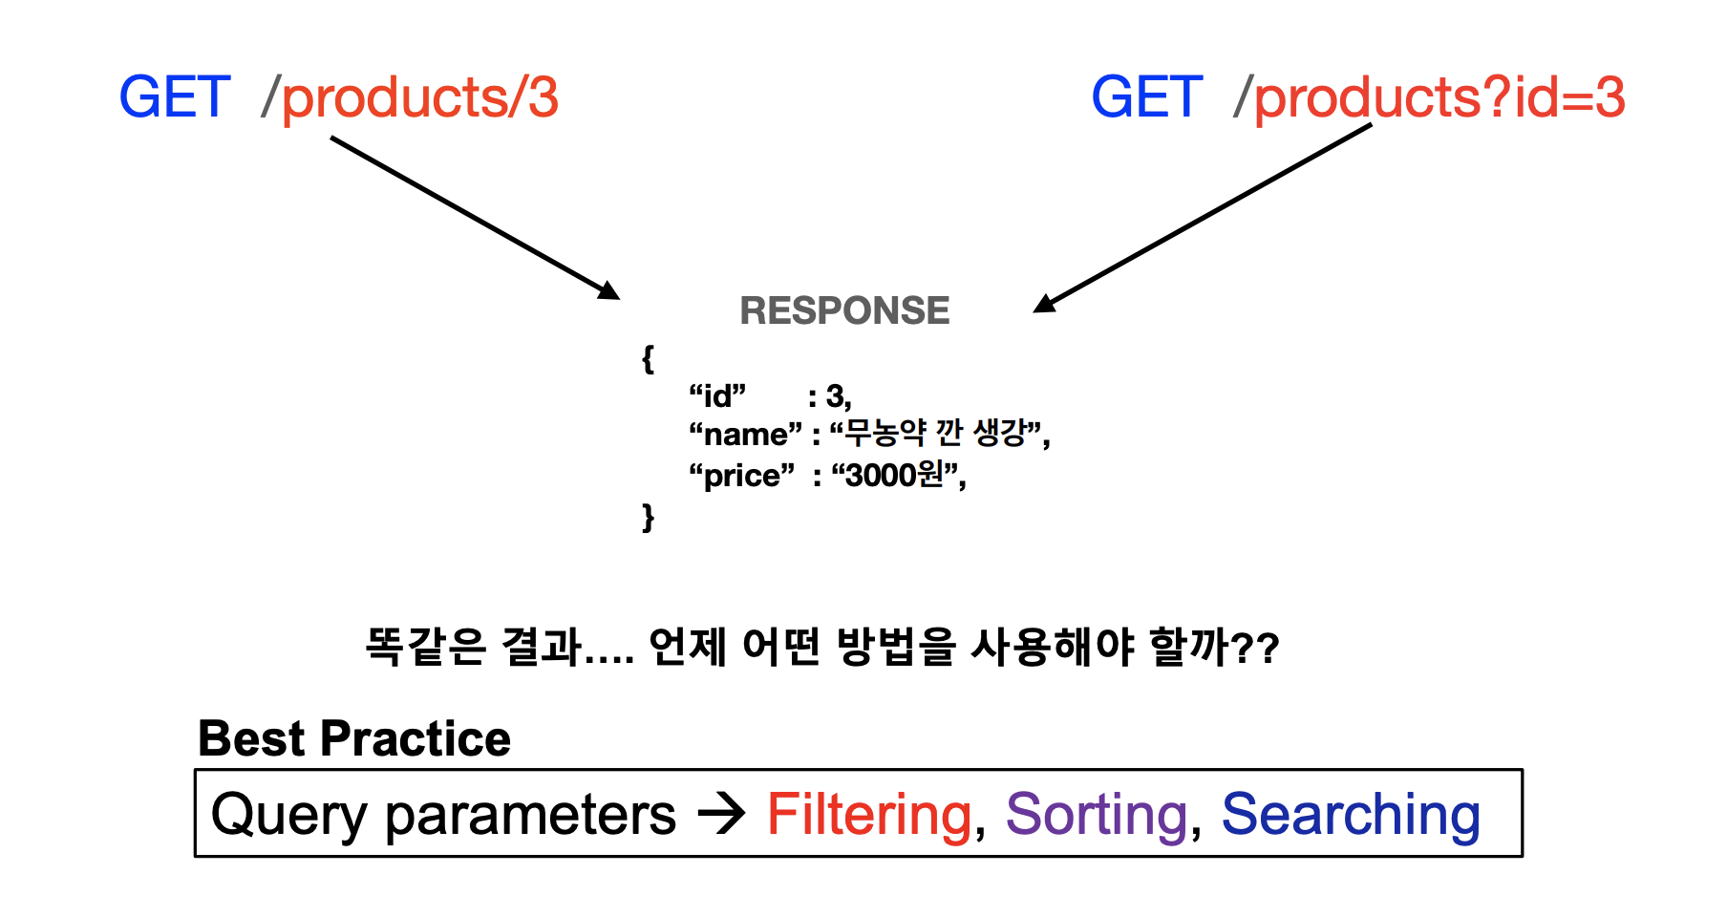
URL, resource, parameters

Slide 53

REST vs GraphQL

Slide 54

gRPC: comparing API architecture

Slide 55

gRPC vs REST

Slide 56

gRPC usage example

Slide 57
Questions ?

